Slide 1
Data Science with SQL Server 2016 and R
Oliver Frost

Slide 2
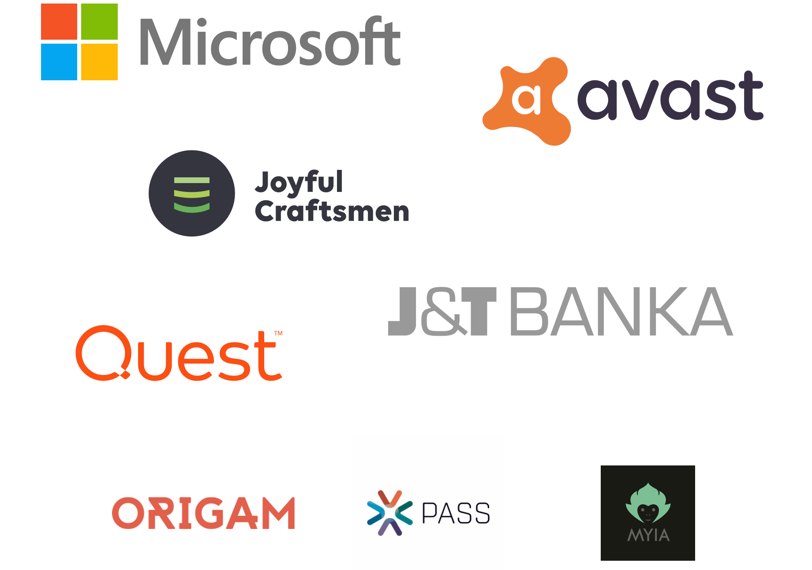
Thanks to our sponsors!

Slide 3
Data Science with SQL Server 2016 and R Oliver Frost

Slide 4
Data Science with SQL Server 2016 and R with SQL Server Machine Learning Services Oliver Frost

Slide 5
Today’s session
The R and SQL Server “stack”
UPDATE: Python!
DEMO – R and Python inside SQL Server 2017:
Setting up
Executing scripts
DEMO – Data Science with RevoScaleR and RevoScalePy:
What are the libraries for?
Explore, summarise and plot data
Predictive modelling and big data

Slide 6







Introductions and Background
SQL Server 2012, 2014, 2016 and 2017
SSIS and SSAS
SQL Server on Azure
SQL Server R Services
LinkedIn: https://www.linkedin.com/in/olliefrost/
Twitter: @OFrost

Slide 7
Relational vs Non-relational

Slide 8
Relational databases overview
Advantages of relational:
Efficient, structured storage.
Keeps data consistent.
Complex querying language for retrieving data, updating, inserting, deleting.
Used for:
Modelling relationships between entities.
Reporting and decision-making.

Slide 9

Relational and NoSQL together
What can R do that SQL can’t?
Great for statistical analyses, machine learning, handling unstructured data.
Becoming a more general programming language.
Daily workload with R and SQL Server:
Structured, modelled data lives and is updated in SQL. Changes logged.
R is for ad hoc analyses on clean files, reshaping data files or reading non-flat files.
Quick to import, do a business analysis piece on, clean up and import, all in memory.

Slide 10

What is R?
R is an open-source programming language, developed by academics and statisticians.
High level language, easy to learn.
Short development cycles.
Written in C, Fortran and R, so performance can be very fast.
Over 6,000 libraries available to use on CRAN.
Now used for cleaning data, ETL, data visualisation, maths, audio and visual analysis, machine learning etc.

Slide 11


Microsoft R
Formerly known as Revolution R
Provides Math Kernel Libraries (MKLs) capable of multithreading – makes R code generally faster.
MS offers three basic products:
R Open – a base
R Client – restricted use of proprietary functions.
R Server – unlimited scalability

Slide 12
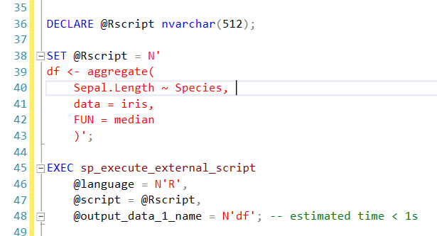
What’s new inside SQL Server 2016?
JSON support.
R and Microsoft R Server integration.
Other features:
Temporal tables.
Row masking and encryption.
Integration with Hadoop, Spark, Teradata.

Slide 13

UPDATE: Python in SQL Server 2017
No need to move data around.
Embed Python scripts inside T-SQL stored procedures.
You will therefore be able to deploy machine learning and AI applications inside SQL Server 2017.
Manage R and Python scripts in the same location.
90k+ libraries – majority of which should be compatible.

Slide 14
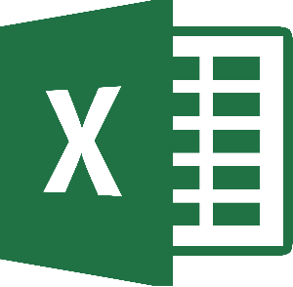







Slide 15
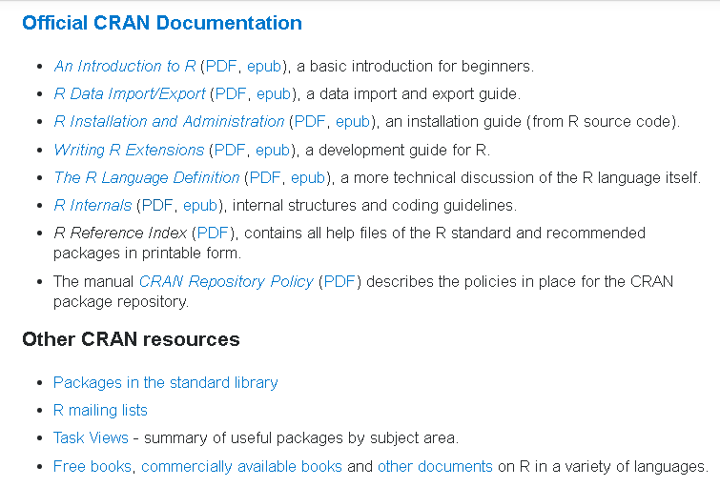
Resources
Stack Overflow:
Documentation Topics
Resources, books, tutorials
Consolidata:
R tutorial series
‘swirl’ library in R:
learn R inside R!

Slide 16
DEMOS

